Slide 1
Unit 2 JS

Slide 2
function functionName([arg1, arg2, ...argN])
{
//code to be executed
}
Example:
<html>
<body>
<script>
function msg()
{
alert("hello! this is message");
}
</script>
<input type="button" onclick="msg()" value="call function"/>
</body>
</html>

Slide 3
<html>
<body>
<script>
function getcube(number){
alert(number*number*number);
}
</script>
<form>
<input type="button" value="click" onclick="getcube(4)"/>
</form>
</body>
</html>

Slide 4
<html>
<head>
<script>
function chkval()
{
var uname=document.frm1.txtname.value;
var upass = document.frm1.txtpass.value;
If (uname=“ ”)
{
Alert(“Username cannot be left blank”);
}
If(upass.length<4)
{
Alert(“Please give password more than 4 characters”);
}
}
</script>
</head>
<body>
<form name=“frm1”>
<input type=“text” name=“txtname”>
<br>
<input type=“password” name=“txtpass”>
<br>
<input type=“button” onclick=“chkval()”>
</form>
</body>

Slide 5
<html>
<head>
<script>
function chkval()
{
var num1=parseInt(document.frm1.txtnum.value);
If (num1 % 2 == 0)
{
Alert(“Even Number”);
}
else
{
Alert(“Odd Number”);
}
}
</script>
</head>
<body>
<form name=“frm1”>
<input type=“text” name=“txtnum”>
<br>
<input type=“button” onclick=“chkval()”>
</form>
</body>

Slide 6
<html>
<body>
<script>
function show(...args)
{
let sum = 0;
for (let i of args)
{
sum += i;
}
document.write("Sum = "+sum);
}
show(10, 20, 30);
</script>
</body>
</html>
Rest Parameter
The rest parameter is introduced in ECMAScript 2015 or ES6, which improves the ability to handle parameters.
The rest parameter allows us to represent an indefinite number of arguments as an array. By using the rest parameter, a function can be called with any number of arguments.
The rest parameter is prefixed with three dots (...).

Slide 7
JavaScript Global Variable
A JavaScript global variable is declared outside the function or declared with window object. It can be accessed from any function.
<script>
var value=50;//global variable
function a(){
alert(value);
}
function b(){
alert(value);
}
</script>

Slide 8
Declaring JavaScript global variable within function
To declare JavaScript global variables inside function, you need to use window object. For example:
function m()
{
window.value=100; //declaring global variable by window object
}
function n()
{
alert(window.value); //accessing global variable from other function
}

Slide 9
Declaring variable with var, let and const
var and let are both used for variable declaration in javascript but the difference between them is that var is function scoped and let is block scoped. Variable declared by let cannot be redeclared and must be declared before use whereas variables declared with var keyword are hoisted.
<html>
<body>
<script>
document.write(x); Output
var x =10; undefined 10
document.write(x);
</script>
</body>
</html>
<html>
<body>
<script>
document.write(x); Output
let x =10;
document.write(x);
</script>
</body>
</html>

Slide 10
These objects can be put into the following three categories:
Built-in objects
HTML objects
Browser objects (BOM)
Built-in objects include string objects, the Date object, and the Math object. They are referred to as built-in because they really do not have anything to do with Web pages, HTML, URLs, the current browser environment, or anything visual.
HTML objects, in turn, are directly associated with elements of Web pages. Every link and anchor is a JavaScript object. Every form, and every element within a form, is an HTML object. The hierarchical organization of display elements on a Web page is reflected almost exactly in a hierarchical set of nested HTML objects.

Slide 11
Browser objects are at the top of JavaScript's object hierarchy. These objects represent large scale elements of the browser's current environment, and include objects such as window (the current window), history (the list of previously visited pages), and location (the URL of the current page).

Slide 12
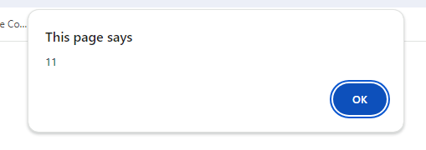
Built-In Objects
1. String Objects
String objects are the most built-in of all the built-in JavaScript objects. You do not even use new when creating a string object. Any variable whose value is a string is actually a string object.
String objects have one property, length, and many methods.
<script>
var a = “Hello World”;
alert(a.length);
</script>

Slide 13
The following methods can be used on string objects to access, control, or modify their content:
String.charAt( idx )
String.at()
String.indexOf( chr )
String.lastIndexOf( chr )
String.substring( fromidx, toidx )
String.toLowerCase()
String.toUpperCase()
String.concat()
String replace()
String.split()

Slide 14
charAt()
The charAt() method returns the character at a specified index (position) in a string.
<html>
<body>
<form name="frm">
<input type="text" name="txt1"></p>
<script>
var text = “hello";
var x = text.charAt(0);
document.frm.txt1.value = x.toUpperCase();
</script>
</body>
</html>

Slide 15
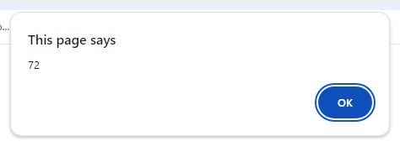
charCodeAt
This method returns the Unicode (ASCII) of the character at a given position in a string.
<script>
var a = "Hello World";
alert(a.charCodeAt(0));
</script>

Slide 16
String.at()
The at() method returns the character at a specified index (position) in a string.
<script>
var a = "Hello World";
alert(a.at(4));
</script>

Slide 17
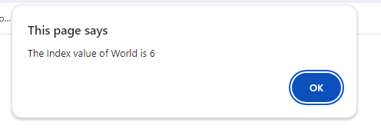
IndexOf
indexOf() returns the position of the first occurrence of a value in a string.
<script>
var a = "Hello World";
alert("The Index value of World is " + a.indexOf("World"));
</script>

Slide 18
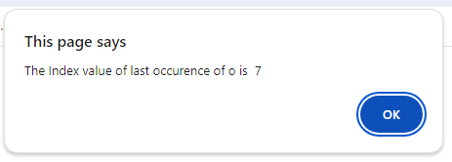
lastIndexOf
lastIndexOf() returns the index of the last occurrence of a specified value in a string.
<script>
var a = "Hello World";
alert("The Index value of last occurence of o is " + a.lastIndexOf("o"));
</script>

Slide 19
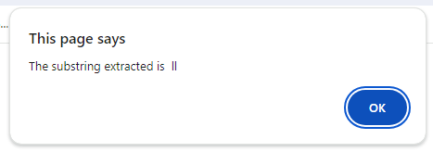
substring(start, end)
substring() extracts a part of a string. From start to end-1.
<script>
var a = "Hello World";
alert("The substring extracted is " + a.substring(2,4));
</script>

Slide 20
concat()
The concat() method joins two or more strings.
<script>
var a = "Hello";
var b = "World";
alert("The substring extracted is " + a.concat(b));
</script>
<script>
var a = "Web";
var b = "Tech";
var c = "Class"
alert("The substring extracted is " + a.concat(b,c));
</script>

Slide 21
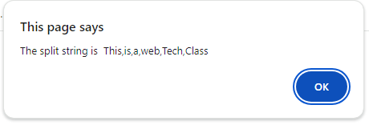
Split()
This function splits a string into an array of substrings, and returns the array.
<script>
var a = "This is a web Tech Class";
alert("The split string is " + a.split(" "));
</script>

Slide 22
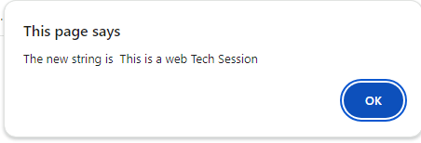
replace()
<script>
var a = "This is a web Tech Class";
alert("The new string is " + a.replace("Class", "Session"));
</script>

Slide 23
2. Math object
The Math object has the following methods:
abs( num )
cos( ang )
exp( num )
log( num )
max( num1, num2 )
max( num1, num2 )
pow( num1, num2 )
random()
round( num )
sin( ang )
sqrt( num )
tan( ang)

Slide 24
Number to Integer
Math.round()
It returns the nearest integer.
Math.round(3.6); Output: 4
Math.ceil()
Math.ceil() rounds a number up to its nearest integer
Math.ceil(4.1); Output: 5
Math.round()
It returns the value of x rounded down to its nearest integer.
Math.floor(4.9); Output: 4

Slide 25
Math.pow()
It returns the value of x to the power of y.
Math.pow(8, 2); Output : 64
Math.sqrt()
Math.sqrt(64); Output : 8
It returns the square root of x.
Math.sin()
It returns the sine of the angle x.

Slide 26
Math.min() and Math.max()
Math.min() and Math.max() can be used to find the lowest or highest value in a list of arguments.
Math.min(0, 150, 30, 20, -8, -200);
Math.random()
Math.random() returns a random number between 0 (inclusive), and 1 (exclusive)
0 to 0.9
<script>
document.write(Math.trunc(Math.random()*10))
</script>

Slide 27
3. Date Object
The Date object is useful for designing sites that are sensitive to the time of day, or use time-based information to present to the user new information. You cannot work with dates prior to 1/1/70.
It differs from the String object in that you use a statement called new to create it.
Using the new statement, you create a Date object that contains information down to the millisecond at that instant.
today = new Date();
getDate | today.getDate()
getDay | yesterday.getDay()
getHours | today.getHours()
getMinutes | today.getMinutes()
getMonth | year.getMonth()

Slide 28
getDate() : It returns the integer value between 1 and 31 to represent the day of the month.
getDay(): It returns the integer value between 0 and 6 to represent the day of the week.
getFullYears(): It returns the year value.
getMonth(): It returns a value between 0 and 11 to represent the month.
getHours(): It returns a value between 0 and 23 to represent hours as per local time.
getMinutes(): It returns a value between 0 and 59 to represent minutes as per local time.

Slide 29
Number Object
IsFinite(): It determines whether the given value is a finite number.
Number.isFinite(x)
IsInteger(): Returns true if the argument is an integer
parseFloat(): Parses its argument and returns a floating-point number.
parseInt(): Parses its argument and returns a whole number.

Slide 30
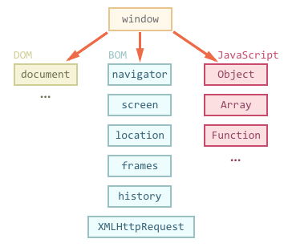
The Browser Object Model (BOM)
The Browser Object Model (BOM) allows JavaScript to "talk to" the browser rather than the content of the page.

Slide 31
The Window Object
The window object is supported by all browsers. It represents the browser's window.
We can call all the functions of window by specifying window or directly. For example:
window.alert("hello world");
is same as:
alert("hello world");

Slide 32
Some important methods of window object
Method] | Description
alert() | displays the alert box containing message with ok button.
confirm() | displays the confirm dialog box containing message with ok and cancel button.
prompt() | displays a dialog box to get input from the user.
open() | opens the new window.
close() | closes the current window.
setTimeout() Setinterval() | performs action after specified time like calling function, evaluating expressions etc. The setInterval() method repeats a block of code at every given timing event.

Slide 33
<html> <head>
<script>
function openWin()
{
myWindow=window.open("","","width=200,height=100");
myWindow.document.write("<p>This is 'myWindow'</p>");
}
function closeWin()
{ myWindow.close(); }
</script> </head>
<body>
<input type="button" value="Open 'myWindow'" onclick="openWin()" />
<input type="button" value="Close 'myWindow'" onclick="closeWin()" />
</body> </html>

Slide 34
confirm() in javascript
<html>
<head>
<script>
function delmsg(){
var x = confirm("Are u sure want to delete?");
if(x==true){
alert(“Content Deleted");
}
else{
alert(“Action Cancelled by User");
}
}
</script>
</head>
<body>
<input type="button" value="delete " onclick=“delmsg()"/>
</body>
</html>

Slide 35
prompt() in javascript
<html>
<head>
<script>
function display(){
var uname = prompt("Enter your name");
document.write("Your Name is" + uname);
}
</script>
</head>
<body>
<input type="button" value="click" onclick=“display()"/>
</body>
</html>

Slide 36
setTimeout()
<SCRIPT LANGUAGE=JAVASCRIPT>
<!--
function mySubmit() {
setTimeout('document.myForm.reset()',2000);
return false;
}
//--></SCRIPT>
<FORM NAME="myForm" onSubmit="return mySubmit()">
<INPUT TYPE="INPUT">
<INPUT TYPE="SUBMIT">
</FORM>

Slide 37
setInterval()
The setInterval() method calls a function or evaluates an expression at specified intervals (in milliseconds).
The setInterval() method will continue calling the function until clearInterval() is called, or the window is closed.
<html>
<body>
<input type="text" id="clock">
<script language=javascript>
function clock()
{
var d=new Date();
var t=d.toLocaleTimeString();
document.getElementById("clock").value=t;
}
setInterval(clock,1000);
</script>

Slide 38
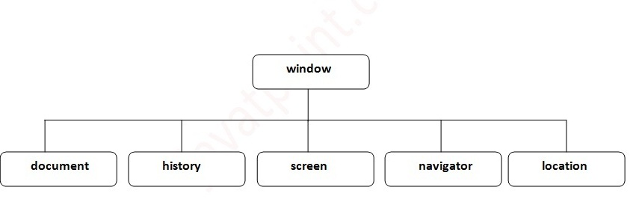
Properties of window object

Slide 39
Object | Description
navigator | The navigator object provides properties that expose information about the current browser to JavaScript scripts.
window | The window object provides methods and properties for dealing with the actual Navigator window, including objects for each frame.
location | The location object provides properties and methods for working with the currently open URL.
history | The history object provides information about the history list and enables limited interaction with the list.
document | The document object is one of the most heavily used objects in the hierarchy. It contains objects, properties, and methods for working with document elements including forms, links, anchors, and with applets.

Slide 40
JavaScript history object
The JavaScript history object represents an array of URLs visited by the user. By using this object, you can load previous, forward or any particular page.
The history object is the window property, so it can be accessed by:
window.history
or,
history

Slide 41
Methods of JavaScript history object
1 | forward() | loads the next page.
2 | back() | loads the previous page.
3 | go() | loads the given page number.
Example of history object
history.back(); //for previous page
history.forward(); //for next page
history.go(2); //for next 2nd page
history.go(-2); //for previous 2nd page

Slide 42
JavaScript Browser object
<html>
<head>
<script type="text/javascript">
function detectBrowser()
{
var browser=navigator.appName;
var b_version=navigator.appVersion;
document.write(browser);
}
</script>
</head>
<body onload="detectBrowser()">
</body>
</html>

Slide 43
Location Object
The location object describes the URL of a document.
Window.location(“url”);
JavaScript Screen Object
The JavaScript screen object holds information of browser screen. It can be used to display screen width, height etc.
it can be accessed by:
window.screen
or,
screen

